Slide 1
Childhood Immunisation Coverage and Inequalities in Nigeria
Public Health Analytics | eHA Academy Data Science Capstone
A data-driven public health analysis
Team: Moses O. Falodun, Muflihat Abdulmajid, Aisha Hilal Galadanchi | 30 October 2026

Slide 2
More than a third of Nigerian children miss their first DTP dose
37.1%
53.4%
39.4%
aged 12-23 months had no DTP1 (zero-dose proxy, NDHS 2023-24)
completed DTP3
fully vaccinated
Who needs this: immunisation programme managers (NPHCDA and State PHC Boards)
Our questions: How has coverage changed? Where and among whom is it lowest? What explains it? What should be done?
Notes:
Programme managers need to know where and among whom to focus outreach.

Slide 3
Two public sources, cleaned and cross-checked
WHO/UNICEF WUENIC survey data: 22 Nigerian surveys (1,140 rows)
DHS Program API: 37 states x 3 surveys = 111 state-survey rows
12 data issues documented and fixed (for example 122 blank survey names, zone rows removed)
The API and WUENIC national values match exactly (difference 0.0)
Surveys are named by fieldwork year: NDHS 2018 and NDHS 2023-24
Notes:
We checked that two independent downloads agree before using either.

Slide 4
Coverage improved modestly, but the zero-dose gap did not close
DTP3: 53.4% (was 50.1%)
DTP dropout: 15.1% (was 23.3%), real progress
Fully vaccinated: 39.4% (was 31.3%)
Zero-dose proxy (100 - DTP1): 37.1% (was 34.7%), no clear improvement
Children with no vaccine of any kind: 19.2% to 30.9%
Surveys disagree: coverage surveys read about 23 points above MICS, so we compare only DHS and MICS
Context: ranks 28th of 32 African countries with a recent DHS or MICS survey
Notes:
Children are finishing the series more often, but too many never start it.

Slide 5
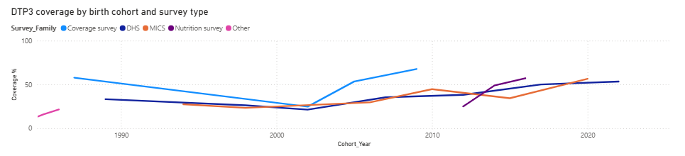
DTP3 coverage by birth cohort and survey type
Source: Power BI dashboard, page 1. Survey types are reported separately and never combined.
Notes:
Each line is a different survey family, so compare trends within a family rather than across them.

Slide 6
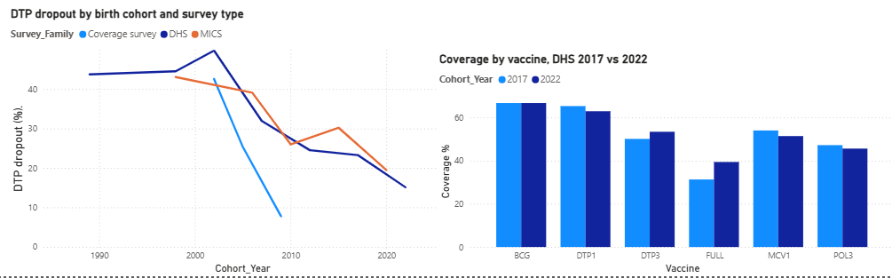
DTP dropout has fallen, and coverage differs by vaccine
Source: Power BI dashboard, page 2.
Notes:
Children are finishing the series more often. Dropout is the gap between the first and third DTP doses.

Slide 7
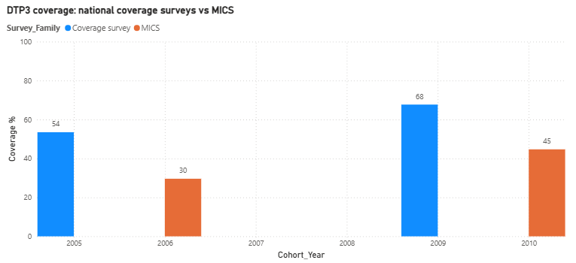
Coverage surveys read about 23 points above MICS
53.5% vs 29.6%
67.7% vs 44.7%
The two survey types measure coverage differently, so we report them separately and compare only DHS and MICS.
Notes:
Source: Power BI dashboard, page 3.

Slide 8
State coverage ranges from 10.9% to 94.6%
Sokoto 10.9% against Cross River 94.6% (DTP3, 2023-24)
12 of 37 states are below 50%; Sokoto, Zamfara and Kebbi are about 11-13%
Zero-dose got worse in 18 of 37 states: Kogi +37.1, Plateau +21.6, Kebbi +14.0 points
Biggest improvements: Gombe -28.7, Katsina -17.7, Bauchi -16.1 points
Small state samples (49 to 271 children): rankings are indicative
Notes:
The national average hides a gap of more than 80 points between states.

Slide 9
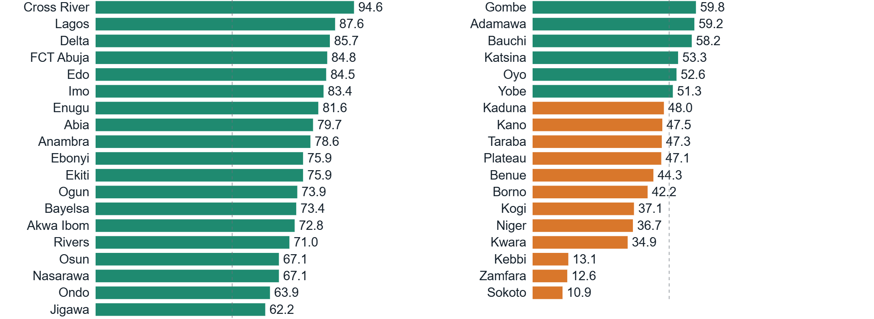
DTP3 coverage by state, 2023-24
Orange: below 50% (12 of 37 states). Dashed line: 50%. Small samples: rankings are indicative.
Notes:
Twelve states are below 50%. The three lowest are Sokoto, Zamfara and Kebbi.

Slide 10
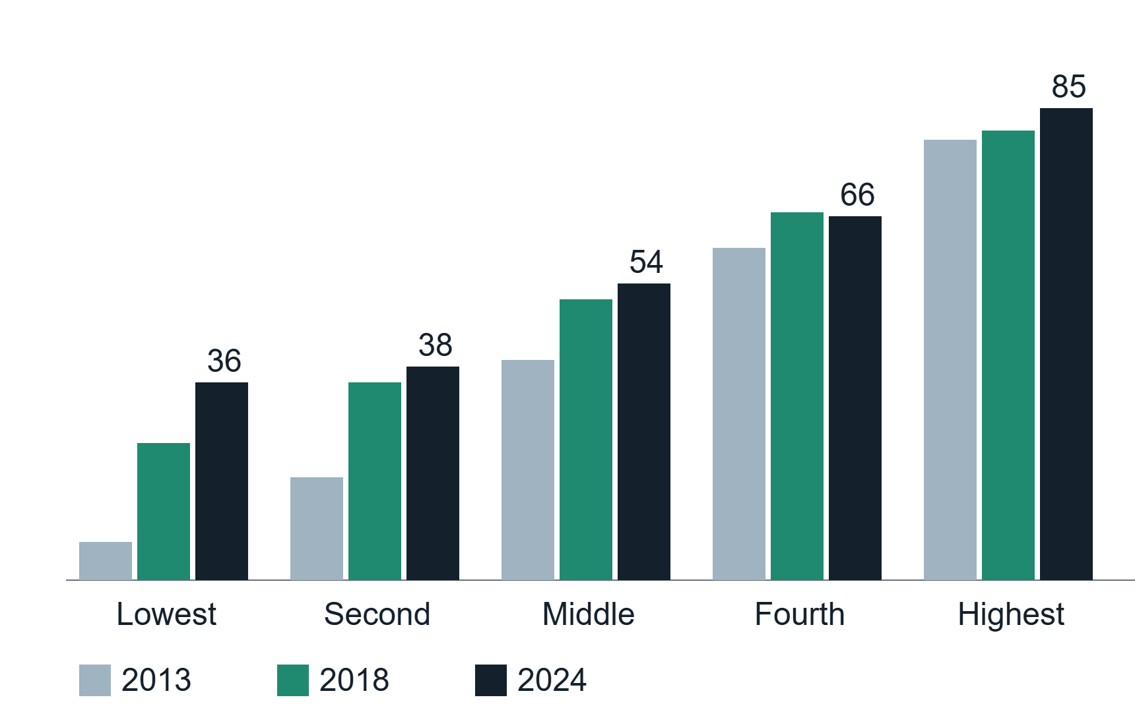
Poverty and mothers' education drive the gap
Poorest fifth 35.7% against richest fifth 85.3% (DTP3, 2024)
Wealth gap narrowed: 72.5, then 56.4, then 49.6 points (2013, 2018, 2024)
Urban-rural gap narrowed from 37.3 to 19.9 points, partly because urban coverage fell (67.9% to 65.4%)
Mothers with no education 33.7% against higher education 88.6%
DTP3 coverage (%) by wealth quintile
Notes:
Gaps are narrowing, but the poorest children are still far behind. Demo cue: a good place for the live Power BI demo (pages 1 to 4).

Slide 11
Can simple indicators explain state coverage, and is a complex model needed?
Data: 111 state-survey rows; targets: DTP3 and zero-dose proxy
8 predictors: antenatal care, facility births, skilled birth attendance, women's education, fertility, poorest-quintile share (none from vaccination data)
Models: training mean (baseline), ridge regression, random forest, gradient boosting
Validation: leave-one-state-out, and train on 2013 and 2018 to predict 2024
Controls: leakage check, fixed seed, every run logged
Notes:
Each test hides whole states or a whole survey year from the model.

Slide 12
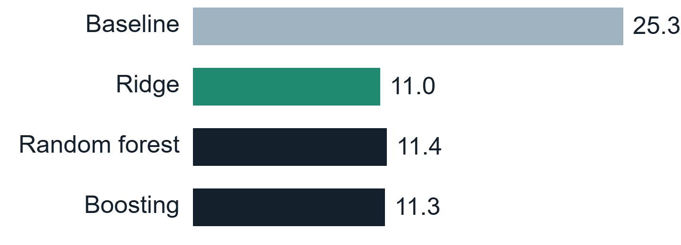
A simple model matches complex ones; women's education matters most
Unseen-state DTP3 error: 25.3 points (baseline) to 11.0 points (ridge), 56% lower
Ridge was best in 3 of 4 comparisons; random forest and boosting added nothing reliable
Women's secondary education is the strongest predictor
Poorly predicted: Ebonyi, Niger, Bauchi (the model should not be trusted there)
DTP3 error, leave-one-state-out (points)
Notes:
With 111 rows, the simple model is the honest choice.

Slide 13
Target outreach where coverage is lowest and falling
Prioritise Sokoto, Zamfara and Kebbi (low coverage) and Kogi, Plateau and Kebbi (worsening zero-dose)
Reach the poorest households and children of mothers with no education
Use antenatal care and facility births as vaccination touchpoints
Track zero-dose with one definition (no DTP1) and confidence intervals every survey round
Use the model to flag states for review, not for single-state decisions
Notes:
These show where to look first; they are not proof of cause.

Slide 14
What this analysis cannot tell us
State averages, not individual children (ecological)
Association, not cause
111 rows; no confidence intervals for states; survey types disagree
Next: apply for NDHS child-level microdata, add confidence intervals, test more predictors
Code, data and experiment log: GitHub [link]
Notes:
We state the limits plainly so the findings can be used safely.

